Slide 1

Introduction
www.brighttomegah.com
by eli tomegah
Notes:
www.brighttomegah.com

Slide 2
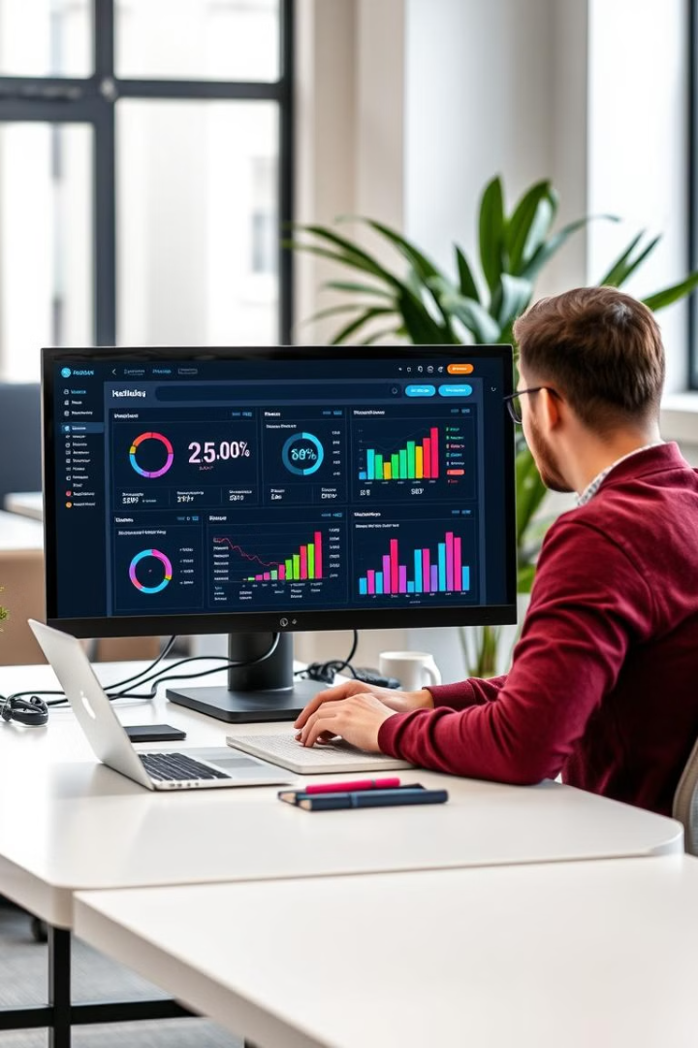
Digital Marketing Career Guide
This presentation will guide you through the digital marketing industry, its different modules, and the career options available in 2025.

Slide 3
The Four Fields of Digital Marketing
Paid Media
Organic Media
Hybrid Media
Analytics
Paid media is one of the most exciting fields in digital marketing, and it’s where a lot of money is made.
Organic media focuses on building a strong online presence through content creation and SEO.
Hybrid media combines paid and organic strategies to maximize reach and impact.
Analytics professionals measure the effectiveness of marketing campaigns and provide insights for improvement.

Slide 4
Paid Media: PPC & Paid Social
PPC
Paid Social
PPC, also called Search Engine Marketing (SEM), focuses on advertising on search engines like Google Search and Bing.
Paid social professionals run advertising campaigns on platforms like Facebook, Instagram, LinkedIn, TikTok, and Snapchat.

Slide 5
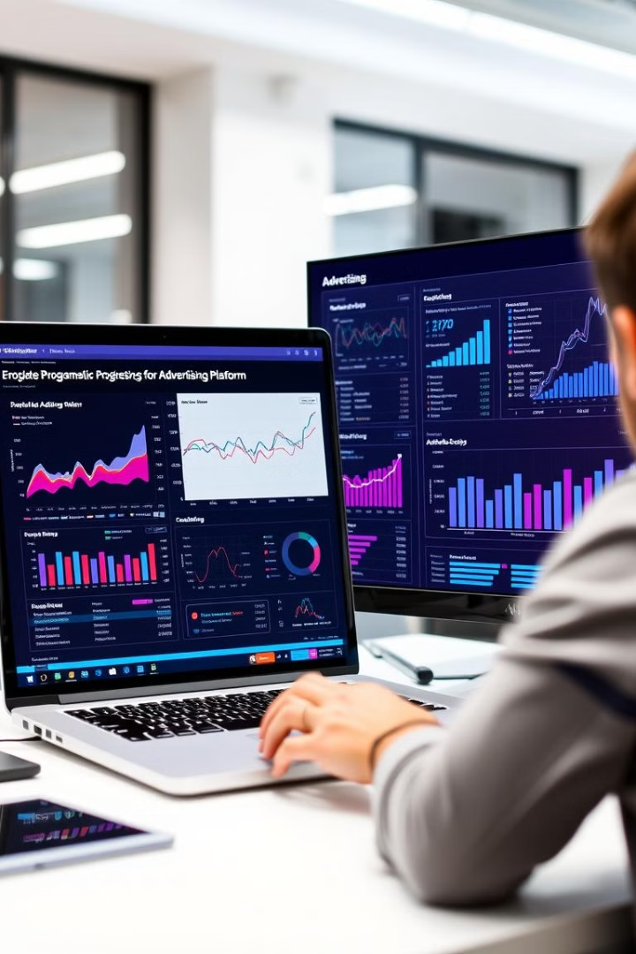
Paid Media: Display, App, & Programmatic Advertising
1
Display Advertising
2
App Advertising
Display advertising involves placing ads on websites and apps.
App advertising focuses on promoting apps through various channels.
3
Programmatic Advertising
Programmatic advertising uses automated technology to buy and sell ad space.

Slide 6
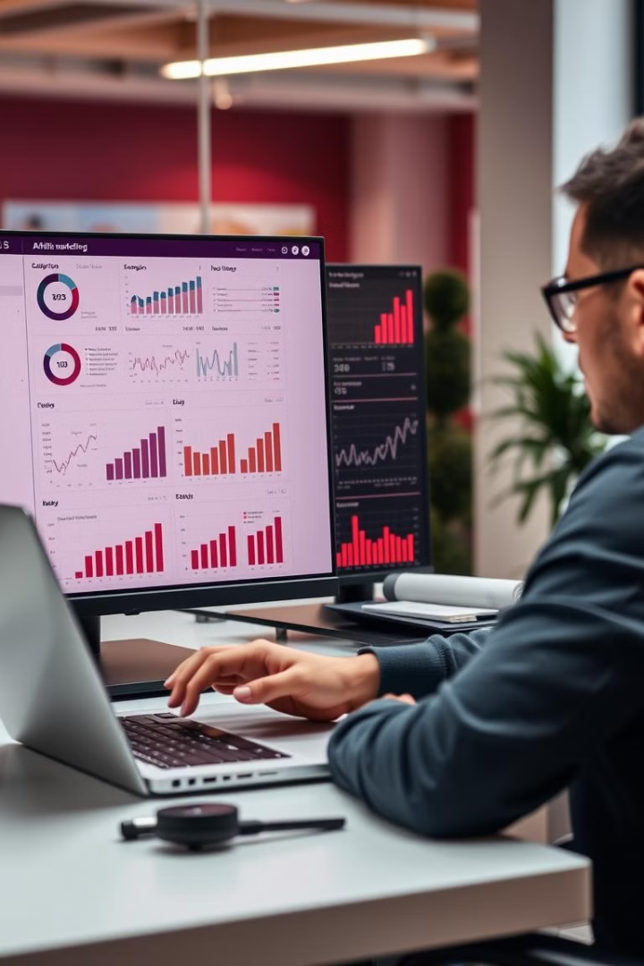
Paid Media: Affiliate Marketing
Affiliate Networks
Commission Structures
Affiliate marketing involves partnering with other businesses to promote products or services.
Companies pay affiliates a commission for each sale or action generated through their referrals.
Tracking & Analytics
Affiliate marketing requires careful tracking and analysis to ensure accurate attribution and prevent fraud.

Slide 7
Organic Media: SEO & ASO
SEO
ASO
SEO (Search Engine Optimization) experts optimize websites to rank higher in search results.
ASO (App Store Optimization) specialists optimize apps to rank higher in search results within app stores.

Slide 8

Organic Media: Social Media Marketing
1
Content Creation
2
Community Management
Social media managers create engaging content to build a strong online presence.
They also moderate comments and engage with audiences on social media platforms.
3
Influencer Marketing
4
Online Reputation Management
Influencer marketing involves partnering with influencers to promote products or services.
ORM specialists monitor reviews and comments across platforms to maintain a positive brand image.

Slide 9
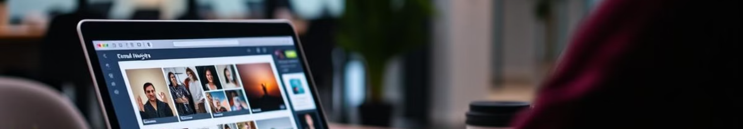
Organic Media: Email Marketing
Automation
1
Email marketing professionals use automation to send targeted emails based on user behavior.
2
Content Creation
They create engaging email copy and design messages to effectively communicate with users.
Data Analysis
3
Email marketing requires data analysis to track performance and optimize campaigns.

